Slide 1
LCMS in SOCIALENERGY project
Project Name: A Gaming and Social Network Platform for Evolving Energy Markets’ Operation and Educating Virtual Energy Communities (SOCIALENERGY)
H2020-ICT-2016-1, ICT-24-2016 on “Gaming and Gamification”
Katina Pancheva (SU-NIS)
Pencho Mihnev (IT – FMI)
<31 March 2018>

Slide 2
Project motivation (1/2)
The purpose of SOCIALENERGY is the easy, rich, and deep communication among the energy sector stakeholders and residential energy consumers that will allow them to:
discover each other and their needs
educate themselves towards a better understanding of the difficulties and the challenges that each one faces
interact and trade with each other, especially in the form of energy efficiency services/products
Vision:
All these will lead to a more energy efficient and finally free from energy dependencies, environmentally friendly society.

Slide 3
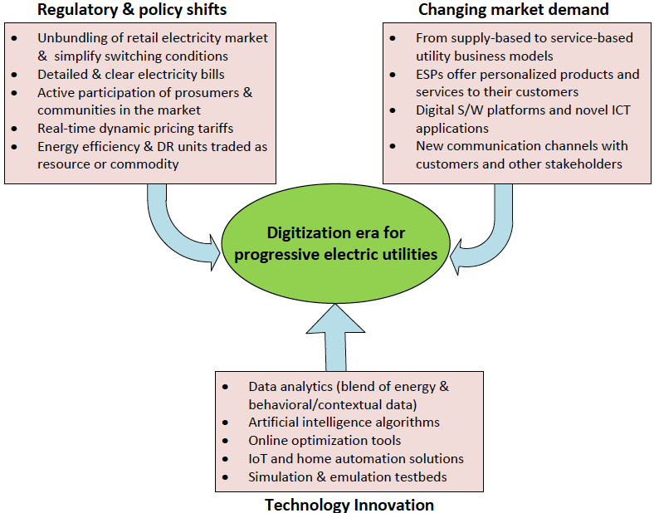
Project motivation (2/2)
Digitization era for electric utilities → confluence of 3 driving forces:
Regulatory & policy shifts
Changing market demand
Technology innovations
SOCIALENERGY Project

Slide 4
Proposed Business Model
Digitization era for electric utilities
From traditional electric utility companies → Energy Service Providers (ESPs)
New Business Model for digital electric utilities:
Research (intelligent algorithms and novel concepts from various disciplines)
Innovation (novel way of exploitation of already existing technologies)
Commercial market uptake (strategic collaborations and release of new products/services in the market)

Slide 5
Proposed SOCIALENERGY S/W platform
A multi-disciplinary S/W platform operated by an electric utility company or energy service provider (ESP)
to accurately inform and effectively educate end users on energy efficiency in a user-friendly way
The self-evolving SOCIALENERGY game integrates several mathematical models and algorithms towards energy efficiency and education of users
The concept on online social networks is exploited through the development of the Green Social Response Network (GSRN) concept, combined with behavioral economics models (such as peer pressure).
These lead to the creation, dynamic adaptation and management of virtual energy communities (VECs)
that trigger very effectively behavioral changes towards energy efficiency.
An innovative hybrid demand response (DR) strategy is developed, which combines incentive-based and price-based DR
through the use of advanced user engagement technologies and exploitation of financial incentives.
A competence based educational (CBE) framework is introduced aiming to:
create the best ‘individual learning plan’ (ILP) for each individual SOCIALENERGY user,
and subsequently guide him/her through the whole online learning and user engagement process.

Slide 6
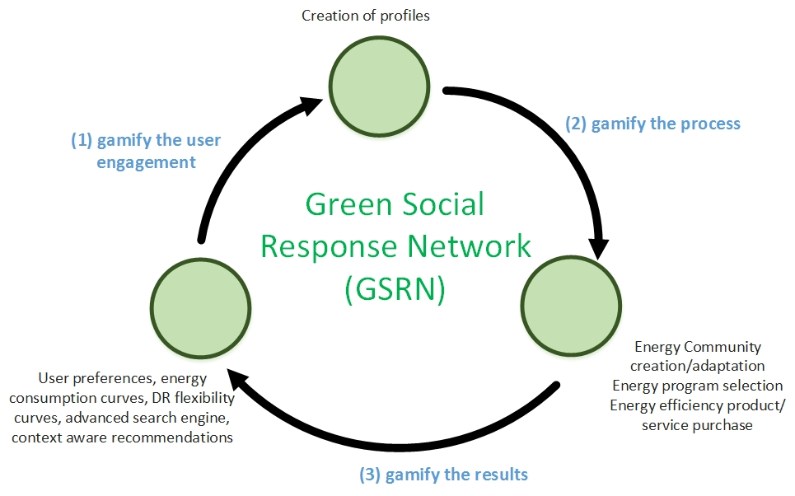
Green Social Response Network (GSRN) concept
The proposed GSRN is:
Green, because
it facilitates and enables the use of clean energy and good practices on EE focusing on the residential sector.
Social, because
its users are able to participate in Virtual Energy Communities (VECs) and communicate with other peers, who have the same interests or even communicate with other commercial stakeholders understanding better their needs/interests.
Response Network, because
it enables/facilitates efficient DR procedures to take place and motivates the individual energy consumers to change their behaviour in the way that they consume energy in their everyday lives.

Slide 7
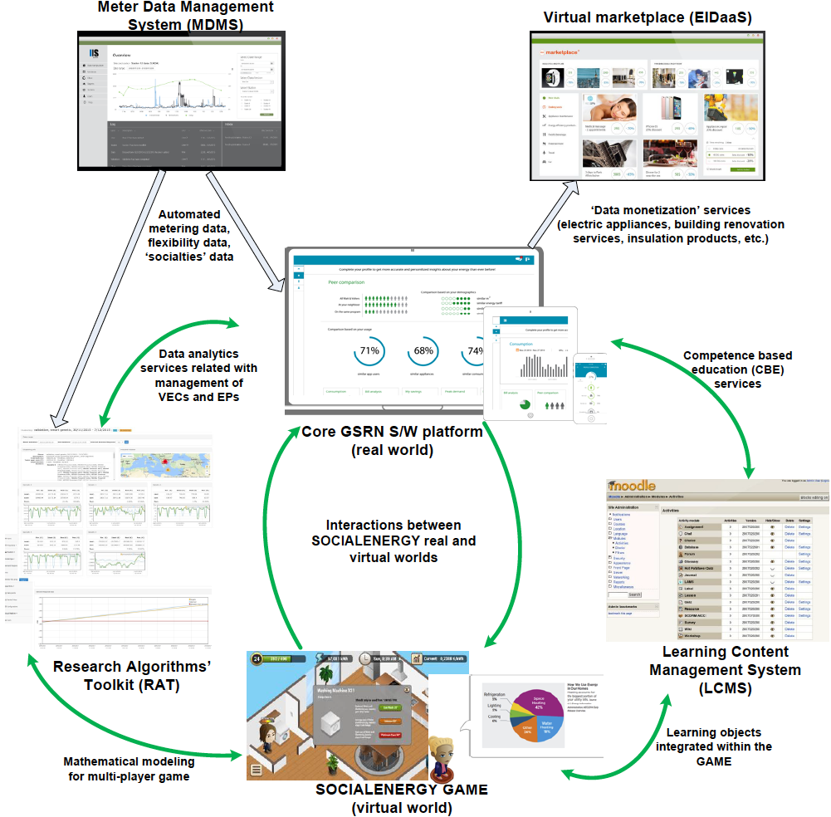
SOCIALENERGY architecture
INTELEN
SU-NIS
ICCS
NRG

Slide 8
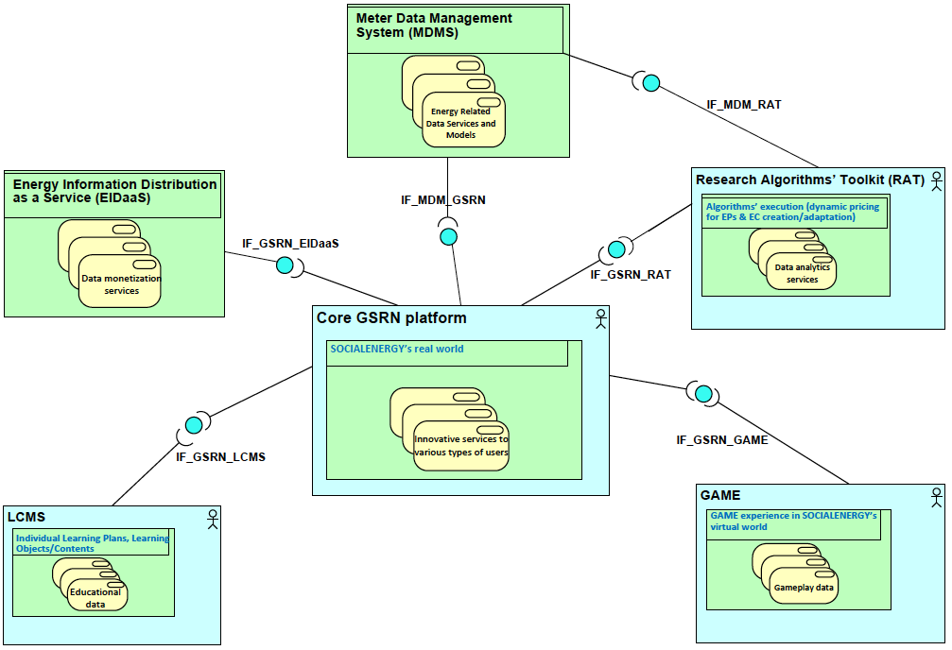
SOCIALENERGY architecture & APIs
INTELEN
ICCS
SU-NIS
NRG

Slide 9
Subsystems
MDMS
Collects all energy consumption related data is. It serves as SOCIALENERGY’s database, where all energy-related data models are also available (e.g. electric appliance consumption models).
GSRN
the core S/W platform of the SOCIALENERGY system, in which all types of SOCIALENERGY users are able to log-in and visualise/experience all innovative functionalities.
SOCIALENERGY GAME
will be played by the user in a range of platforms starting from a basic web-based implementation and possibly being extended to a mobile application, too. After the SOCIALENERGY user (i.e. individual consumer) is logged in the GSRN, s/he uses the same credentials to download the game and start the gameplay.
RAT
very important subsystem for SOCIALENERGY’s operation because it provides all the intelligence that is required towards making SOCIALENERGY S/W platform competitive enough and commercially successful in a sustainable manner.
LCMS
the subsystem, where the user/player educates herself/himself both online and offline to consolidate the new knowledge about good practices on energy efficiency.
EIDaaS
through it SOCIALENERGY bridges the gap between energy consumers and companies as well as among multiple other stakeholders related to the energy efficiency sector.

Slide 10
Major achievements achieved by SU-NIS
A novel SOCIALENERGY competence taxonomy framework has been designed and the way that the learning objects/units from LCMS will be integrated in, has been agreed
A first S/W prototype version of the LCMS subsystem is currently ready for DEMO

Slide 11
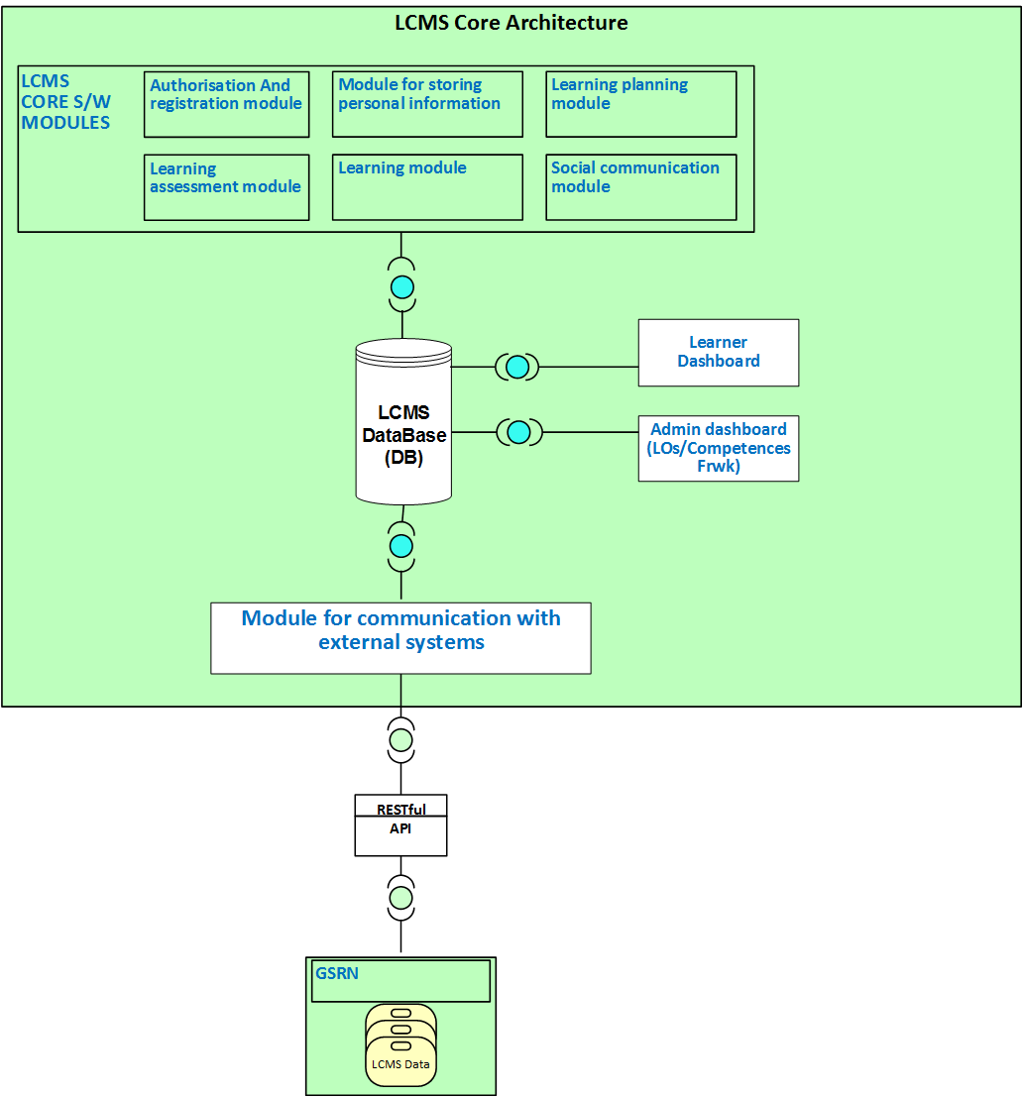
Learning Content Management System (LCMS)

Slide 12
Learning Content Management System Role
Context
Increasing exploitation and impact of DR EPs and energy efficient products and services and their complexity impose strong need to educate people.
Social inclusion towards energy efficiency
Enhancement of easy and deep communication between all stakeholders (users, utilities, providers, energy efficiency companies, intermediaries, ESCOs)
Importance of collective, bottom-up and self-organized online education

Slide 13
LCMS Role
Context:
Purpose of SE to educate all stakeholders to understand and cope with difficulties and challenges related to energy efficiency.
Game as major tool to address SE objective to educate users, and LCMS as an important tool to complement with standard educational services.
LCMS performs important base function in overall educational processes in SE project

Slide 14
LCMS Features
LCMS is:
web-based platform with a default mobile-compatible interface and cross-browser compatibility
a single, robust, secure and integrated system for the creation of personalized learning environment
based on Moodle – a continually reviewed and improved to suit the evolving needs of users
interrelated with other subs-systems (GSRN and game)
LCMS provides:
to educators, administrators and learners a set of learner-centric tools
personalized learning (ILP related to courses/modules, dashboard etc)
collaborative learning environment
social functions (communication with others, chats, forums etc.)

Slide 17
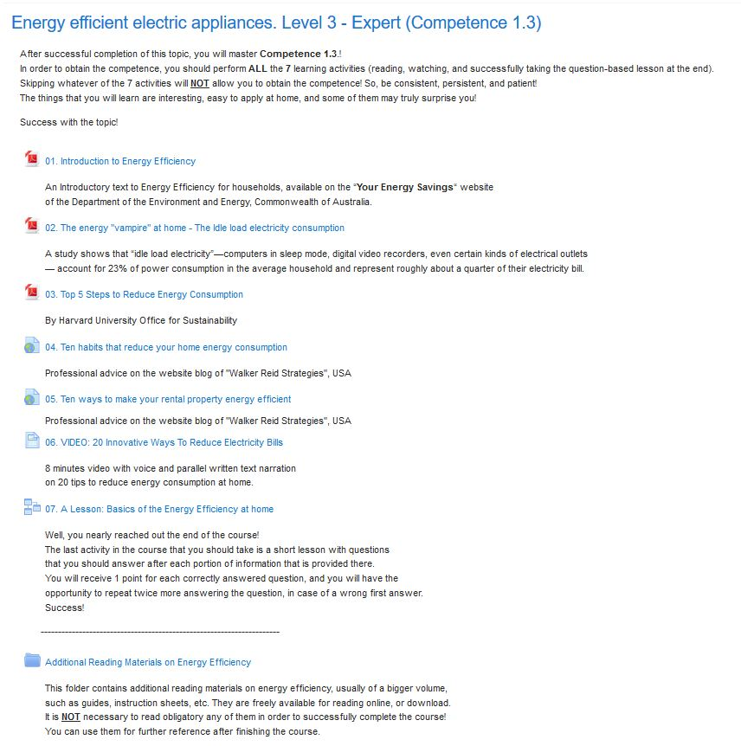
Course on Competence 1.3. Energy efficient electric appliances, Level 3 - Expert

Slide 18
LCMS Resources and Activities that will be mostly used in a learning module/course
Resources
Activities
File
Page (web)
URL
Book
Glossary
Recording (from BigBlueButton)
External Package (SCORM, IMS)
Folder (organisational)
Label (organisational)
Automatically graded
Quiz / External pack quiz (SCORM)
Choice
Lesson
Assignment
For Communication/Collaboration
Forum / Chat
BigBlueButton (BN)
Workshop / Database

Slide 19
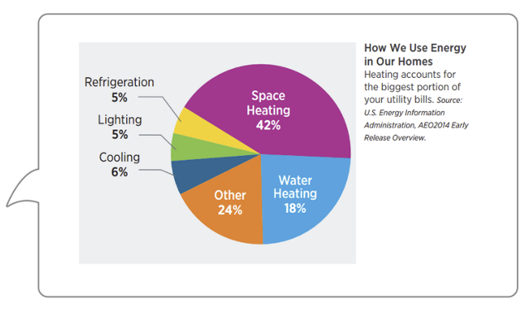
Interaction of LCMS with GSRN and the GAME
Interaction with GSRN
GSRN provides to LCMS recommendations – what competences a user needs to master
GSRN provides to LCMS user model to be used in education
LCMS provides GSRN with results of training to be part of the users’ models
LCMS provides GSRN with the SE ontology to be part of each user model
Interaction with game
Offline educational material through pop-up windows
Developed learning material is integrated in SOCIALENERGY’s virtual world
LCMS enhances users lessons learnt through the game playing with new knowledge

Slide 20
LCMS services (v0p4)
Search for users – retrieval of users via criteria to match
List competencies – retrieval of list of competencies
Create learning plan for a user
Add a competency to a learning plan
List a user’s learning plans
List a learning plan's competencies
List courses using a competency
List badges awarded to a user
List user’s course final grades
List of grade items for users in a course
List dedication estimated time to a course by the participants

